Slide 1
Improving BBR for High-Latency, Low-Bandwidth Networks
Aitik Dandapat (116626453)
Anirban Ghosh (115221844)
Nikhil Bambal (116551326)

Slide 2
Introduction
Importance of congestion control in network performance
Limitations of BBR in high-latency, low-bandwidth scenarios (e.g., satellite, rural 5G)
Notes:
Lack of context awareness: Existing notification systems often fail to consider the user's current activity, location, or time of day when delivering notifications.
One-size-fits-all approach: Most smartphone interfaces do not adapt to individual user needs, preferences, or abilities, potentially limiting accessibility and usability for diverse user groups.
Information overload: The sheer volume of notifications can overwhelm users, leading to decreased productivity and increased stress levels.
Privacy and security concerns: Collecting and utilizing user data for context recognition raises important privacy and security considerations that need to be addressed.
Battery efficiency: Continuous monitoring of sensor data and context recognition can potentially drain smartphone batteries quickly, affecting overall device usability.

Slide 3
Problem Statement
Issues faced by BBR:
Unstable throughput
High jitter
Inefficient bandwidth utilization
Notes:
Lack of context awareness: Existing notification systems often fail to consider the user's current activity, location, or time of day when delivering notifications.
One-size-fits-all approach: Most smartphone interfaces do not adapt to individual user needs, preferences, or abilities, potentially limiting accessibility and usability for diverse user groups.
Information overload: The sheer volume of notifications can overwhelm users, leading to decreased productivity and increased stress levels.
Privacy and security concerns: Collecting and utilizing user data for context recognition raises important privacy and security considerations that need to be addressed.
Battery efficiency: Continuous monitoring of sensor data and context recognition can potentially drain smartphone batteries quickly, affecting overall device usability.

Slide 4
Problem Statement
Issues faced by BBR:
Unstable throughput
High jitter
Inefficient bandwidth utilization
Notes:
Lack of context awareness: Existing notification systems often fail to consider the user's current activity, location, or time of day when delivering notifications.
One-size-fits-all approach: Most smartphone interfaces do not adapt to individual user needs, preferences, or abilities, potentially limiting accessibility and usability for diverse user groups.
Information overload: The sheer volume of notifications can overwhelm users, leading to decreased productivity and increased stress levels.
Privacy and security concerns: Collecting and utilizing user data for context recognition raises important privacy and security considerations that need to be addressed.
Battery efficiency: Continuous monitoring of sensor data and context recognition can potentially drain smartphone batteries quickly, affecting overall device usability.

Slide 5
Motivation
Increasing prevalence of high-latency networks
Critical applications (emergency response, remote healthcare)
Necessity for robust network communication
Notes:
Lack of context awareness: Existing notification systems often fail to consider the user's current activity, location, or time of day when delivering notifications.
One-size-fits-all approach: Most smartphone interfaces do not adapt to individual user needs, preferences, or abilities, potentially limiting accessibility and usability for diverse user groups.
Information overload: The sheer volume of notifications can overwhelm users, leading to decreased productivity and increased stress levels.
Privacy and security concerns: Collecting and utilizing user data for context recognition raises important privacy and security considerations that need to be addressed.
Battery efficiency: Continuous monitoring of sensor data and context recognition can potentially drain smartphone batteries quickly, affecting overall device usability.

Slide 6
Technical Approach
Smoothed RTT Filtering
Exponential Weighted Moving Average (EWMA)
High smoothing factor (α ≈ 0.9)
Benefits: Reduces sensitivity to transient RTT spikes
Notes:
Lack of context awareness: Existing notification systems often fail to consider the user's current activity, location, or time of day when delivering notifications.
One-size-fits-all approach: Most smartphone interfaces do not adapt to individual user needs, preferences, or abilities, potentially limiting accessibility and usability for diverse user groups.
Information overload: The sheer volume of notifications can overwhelm users, leading to decreased productivity and increased stress levels.
Privacy and security concerns: Collecting and utilizing user data for context recognition raises important privacy and security considerations that need to be addressed.
Battery efficiency: Continuous monitoring of sensor data and context recognition can potentially drain smartphone batteries quickly, affecting overall device usability.

Slide 7
Technical Approach - continued
Extended Gain Cycle
Increasing gain cycle from 4 to 6 phases
Stable "plateau" phases for better bandwidth probing
Benefits: Accurate bandwidth estimation, increased throughput stability
Notes:
Lack of context awareness: Existing notification systems often fail to consider the user's current activity, location, or time of day when delivering notifications.
One-size-fits-all approach: Most smartphone interfaces do not adapt to individual user needs, preferences, or abilities, potentially limiting accessibility and usability for diverse user groups.
Information overload: The sheer volume of notifications can overwhelm users, leading to decreased productivity and increased stress levels.
Privacy and security concerns: Collecting and utilizing user data for context recognition raises important privacy and security considerations that need to be addressed.
Battery efficiency: Continuous monitoring of sensor data and context recognition can potentially drain smartphone batteries quickly, affecting overall device usability.

Slide 8
Experimental Methodology
Metrics Evaluated
Mean Throughput: The average data transfer rate (in Mbps) achieved over the entire test interval.
Throughput Variance: The statistical variance of the throughput time series, quantifying how much delivery rate fluctuates.
Average CWND: The mean size of the congestion window (in packets) throughout the experiment, reflecting sustained sending capacity.
Maximum CWND: The largest congestion window value (in packets) observed, indicating peak burst capacity.
Notes:
Lack of context awareness: Existing notification systems often fail to consider the user's current activity, location, or time of day when delivering notifications.
One-size-fits-all approach: Most smartphone interfaces do not adapt to individual user needs, preferences, or abilities, potentially limiting accessibility and usability for diverse user groups.
Information overload: The sheer volume of notifications can overwhelm users, leading to decreased productivity and increased stress levels.
Privacy and security concerns: Collecting and utilizing user data for context recognition raises important privacy and security considerations that need to be addressed.
Battery efficiency: Continuous monitoring of sensor data and context recognition can potentially drain smartphone batteries quickly, affecting overall device usability.

Slide 9
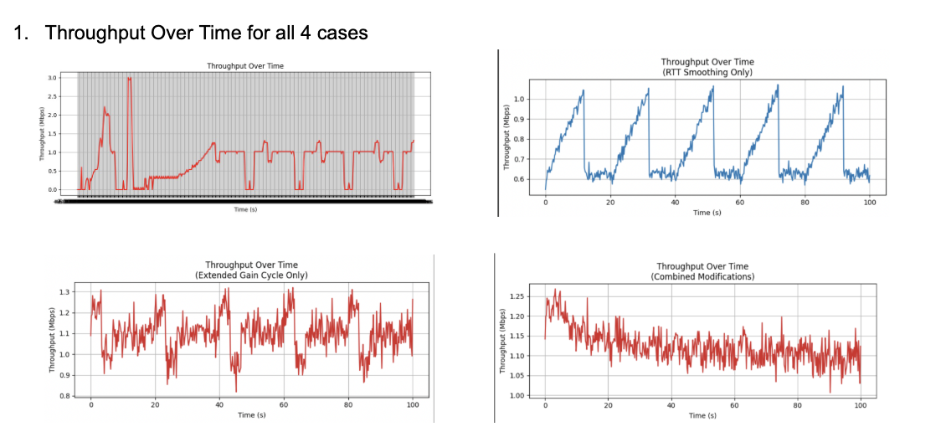
Experiment Results
Notes:
Lack of context awareness: Existing notification systems often fail to consider the user's current activity, location, or time of day when delivering notifications.
One-size-fits-all approach: Most smartphone interfaces do not adapt to individual user needs, preferences, or abilities, potentially limiting accessibility and usability for diverse user groups.
Information overload: The sheer volume of notifications can overwhelm users, leading to decreased productivity and increased stress levels.
Privacy and security concerns: Collecting and utilizing user data for context recognition raises important privacy and security considerations that need to be addressed.
Battery efficiency: Continuous monitoring of sensor data and context recognition can potentially drain smartphone batteries quickly, affecting overall device usability.

Slide 10
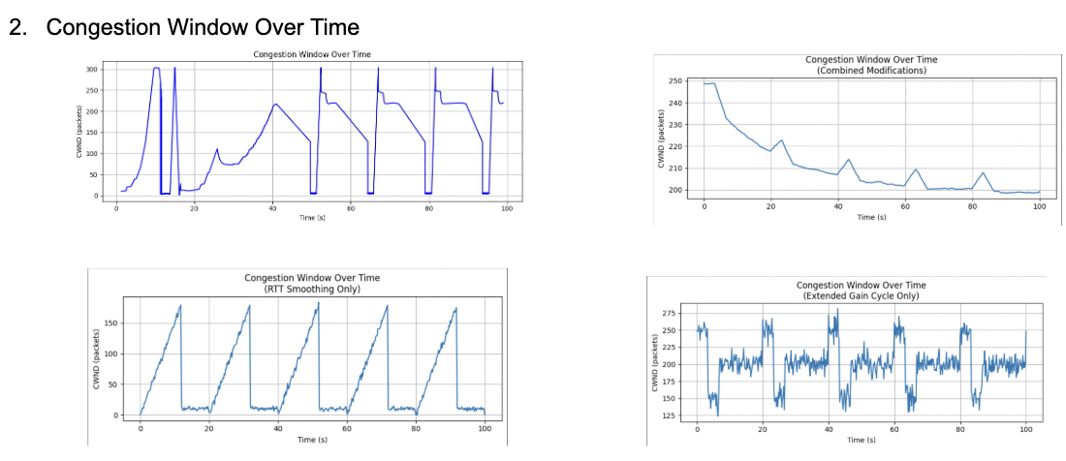
Experiment Results - continued
Notes:
Lack of context awareness: Existing notification systems often fail to consider the user's current activity, location, or time of day when delivering notifications.
One-size-fits-all approach: Most smartphone interfaces do not adapt to individual user needs, preferences, or abilities, potentially limiting accessibility and usability for diverse user groups.
Information overload: The sheer volume of notifications can overwhelm users, leading to decreased productivity and increased stress levels.
Privacy and security concerns: Collecting and utilizing user data for context recognition raises important privacy and security considerations that need to be addressed.
Battery efficiency: Continuous monitoring of sensor data and context recognition can potentially drain smartphone batteries quickly, affecting overall device usability.

Slide 11
Experiment Results - continued
Scenario | Mean Throughput (Mbps) | Variance of Avg Throughput | Avg CWND (pkts) | Max CWND (pkts)
Original | 1.098 | 0.010 | 200.2 | 281.6
RTT Smoothing Only | 0.742 | 0.020 | 56.9 | 181.6
Extended Gain Only | 1.103 | 0.008 | 200.4 | 279.2
Combined Modifications | 1.122 | 0.002 | 209.6 | 247.9
Notes:
Lack of context awareness: Existing notification systems often fail to consider the user's current activity, location, or time of day when delivering notifications.
One-size-fits-all approach: Most smartphone interfaces do not adapt to individual user needs, preferences, or abilities, potentially limiting accessibility and usability for diverse user groups.
Information overload: The sheer volume of notifications can overwhelm users, leading to decreased productivity and increased stress levels.
Privacy and security concerns: Collecting and utilizing user data for context recognition raises important privacy and security considerations that need to be addressed.
Battery efficiency: Continuous monitoring of sensor data and context recognition can potentially drain smartphone batteries quickly, affecting overall device usability.

Slide 12
Analysis of Results
Combined Modifications achieves the highest mean throughput and the lowest variance, indicating both higher and more stable throughput.
It also has the highest average congestion window, reflecting its ability to sustain a larger window over time.
While its peak CWND (247.9) is slightly below the original’s maximum, the combination yields overall better performance and consistency across all metrics.
Notes:
Lack of context awareness: Existing notification systems often fail to consider the user's current activity, location, or time of day when delivering notifications.
One-size-fits-all approach: Most smartphone interfaces do not adapt to individual user needs, preferences, or abilities, potentially limiting accessibility and usability for diverse user groups.
Information overload: The sheer volume of notifications can overwhelm users, leading to decreased productivity and increased stress levels.
Privacy and security concerns: Collecting and utilizing user data for context recognition raises important privacy and security considerations that need to be addressed.
Battery efficiency: Continuous monitoring of sensor data and context recognition can potentially drain smartphone batteries quickly, affecting overall device usability.

Slide 13
Conclusion
Our targeted algorithmic enhancements effectively address BBR's performance gaps in high-latency, low-bandwidth environments. By applying RTT smoothing and extending gain cycles, we significantly improved throughput stability, RTT consistency, and network reliability. This research provides practical, validated solutions suitable for challenging network scenarios.
Notes:
Lack of context awareness: Existing notification systems often fail to consider the user's current activity, location, or time of day when delivering notifications.
One-size-fits-all approach: Most smartphone interfaces do not adapt to individual user needs, preferences, or abilities, potentially limiting accessibility and usability for diverse user groups.
Information overload: The sheer volume of notifications can overwhelm users, leading to decreased productivity and increased stress levels.
Privacy and security concerns: Collecting and utilizing user data for context recognition raises important privacy and security considerations that need to be addressed.
Battery efficiency: Continuous monitoring of sensor data and context recognition can potentially drain smartphone batteries quickly, affecting overall device usability.

Slide 14
Future Work
While we were able to simulate a low bandwidth, high latency network, we were unsuccessful in simulating a lossy network. While retransmissions were achieved simply because of timeouts, in the real world, packet losses are far more common. In further experiments, we would like to test the algorithms on how they perform in these lossy networks.
Notes:
Lack of context awareness: Existing notification systems often fail to consider the user's current activity, location, or time of day when delivering notifications.
One-size-fits-all approach: Most smartphone interfaces do not adapt to individual user needs, preferences, or abilities, potentially limiting accessibility and usability for diverse user groups.
Information overload: The sheer volume of notifications can overwhelm users, leading to decreased productivity and increased stress levels.
Privacy and security concerns: Collecting and utilizing user data for context recognition raises important privacy and security considerations that need to be addressed.
Battery efficiency: Continuous monitoring of sensor data and context recognition can potentially drain smartphone batteries quickly, affecting overall device usability.

Slide 15
References
Cardwell et al., ACM 2017. "BBR: Congestion-Based Congestion Control: Measuring bottleneck bandwidth and round-trip propagation time." Communications of the ACM, vol. 60, no. 2, 2017, pp. 58–66.
Cheng et al., ACM IMC 2019. "When to use and when not to use BBR: An empirical analysis and evaluation study."
"BBR Congestion Control" by Neal Cardwell et al.
Notes:
Lack of context awareness: Existing notification systems often fail to consider the user's current activity, location, or time of day when delivering notifications.
One-size-fits-all approach: Most smartphone interfaces do not adapt to individual user needs, preferences, or abilities, potentially limiting accessibility and usability for diverse user groups.
Information overload: The sheer volume of notifications can overwhelm users, leading to decreased productivity and increased stress levels.
Privacy and security concerns: Collecting and utilizing user data for context recognition raises important privacy and security considerations that need to be addressed.
Battery efficiency: Continuous monitoring of sensor data and context recognition can potentially drain smartphone batteries quickly, affecting overall device usability.

